Slide 1
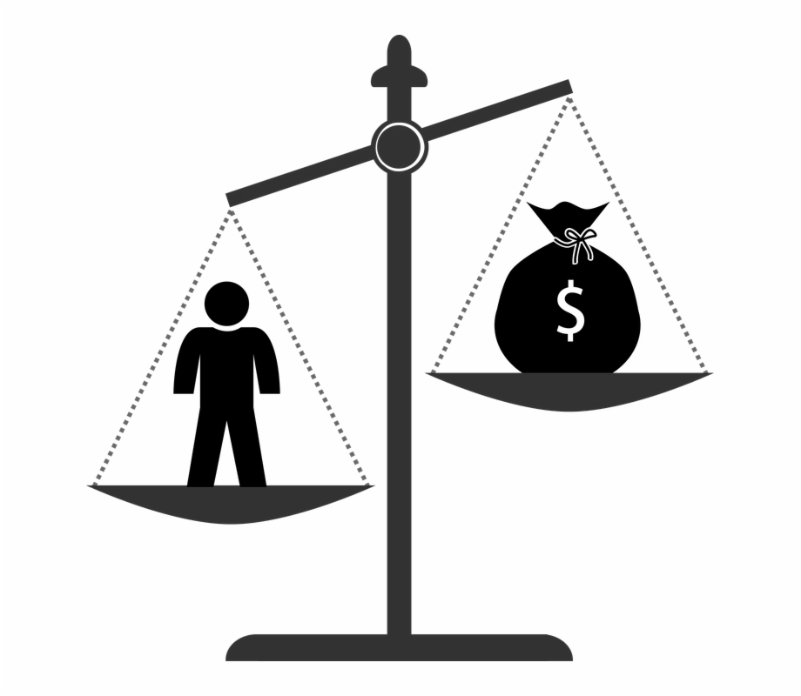
Health and Income
By Elizabeth Senft
DDA3 Capstone

Slide 2
Data Questions?
Is there a relationship between physical health and income, using BMI as a measure of health?
Is there any correlation with states that have higher rates of obesity and median income?
Is the rate of obesity higher in states with high levels of poverty?
What is the average cost of health insurance with an obese BMI verses a normal BMI?
Why is this data and this project relevant?

Slide 3
Overview
Definitions/ Key Considerations
Obesity Rate, Poverty Level, Median Income by state compared to National average
Relationship between income, poverty, obesity
Cost of Obesity
Conclusion
Q&A

Slide 4
Definitions
BMI - Body Mass Index– a measurement index used to evaluate health (calculated using weight in kg/height in meters squared)
Federal Poverty Level – an annual report by the HHS that shows the total cost needed by the average person per year to cover basic necessities such as food, utilities, and accommodation.
Median Income – the middle value for income within the U.S population earned over the past 12 months of that year

Slide 5
Key considerations
Metrics for analysis:
Annual median income $53,102- $65,618
Federal Poverty Level $23,550- $25,750
BMI > = 30.0
Data Timeline 2013, 2016, 2019

Slide 6
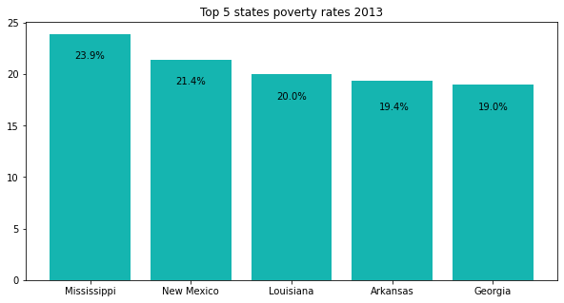
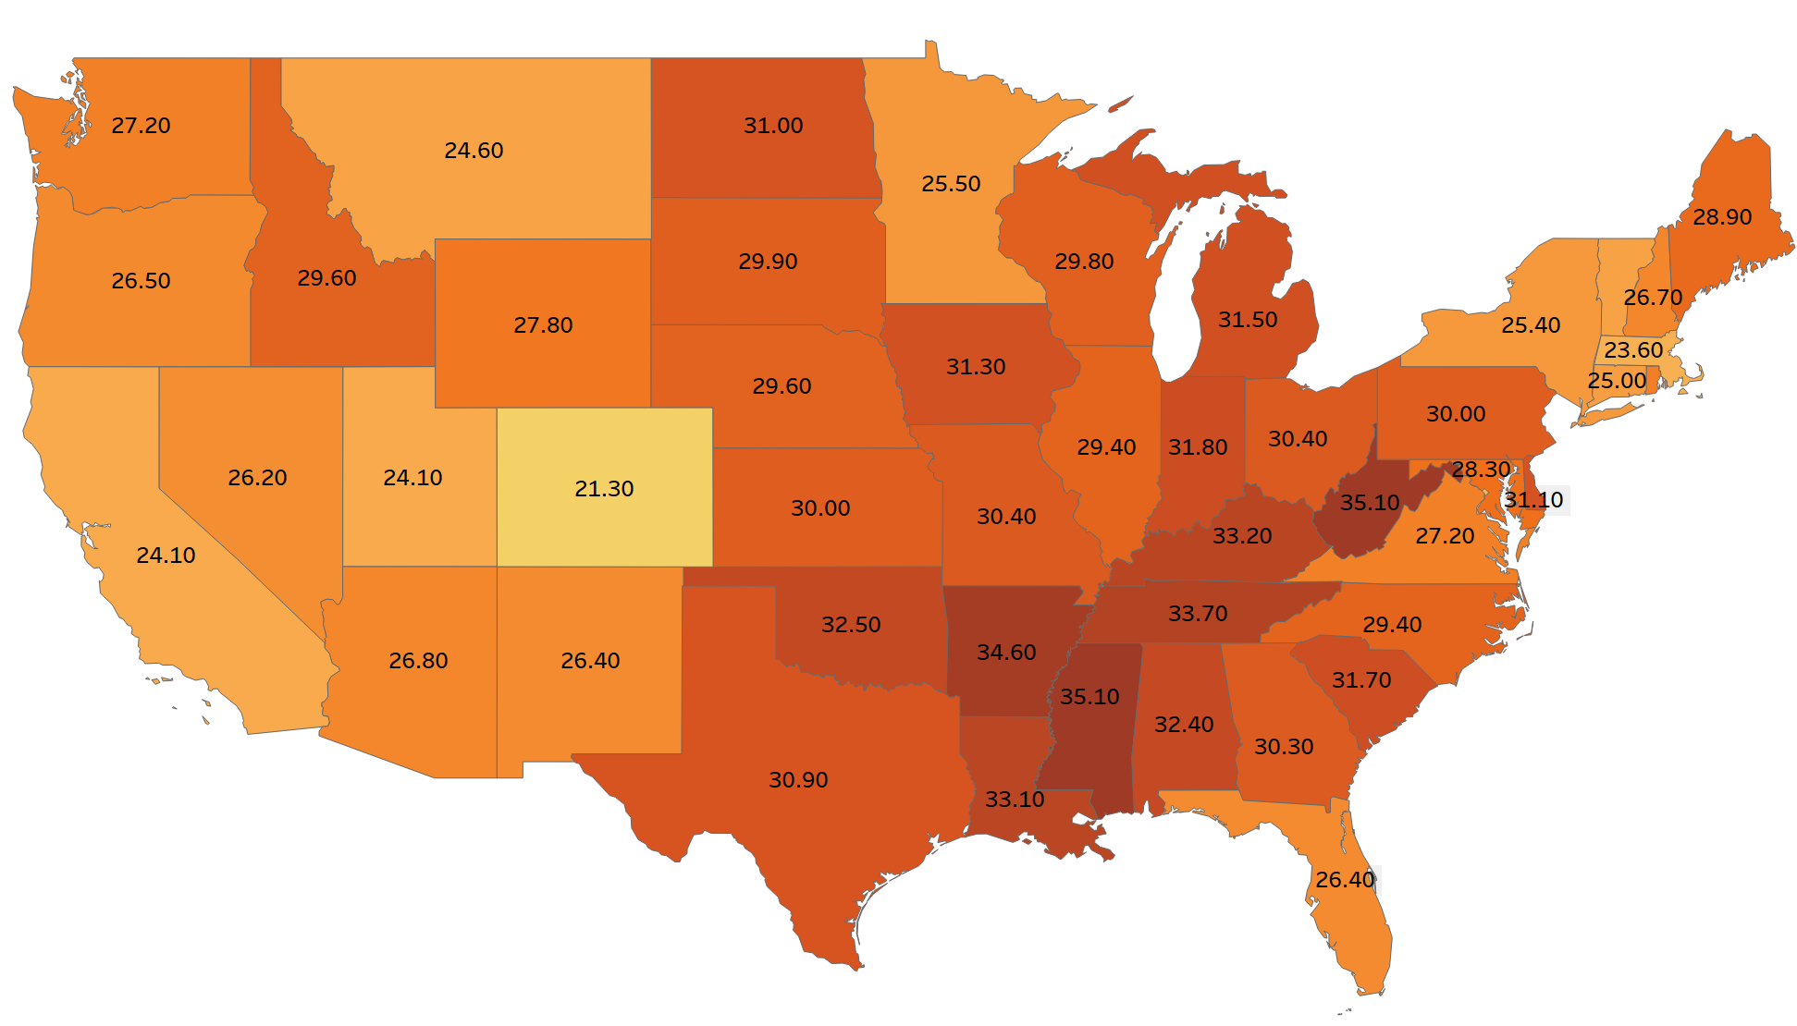
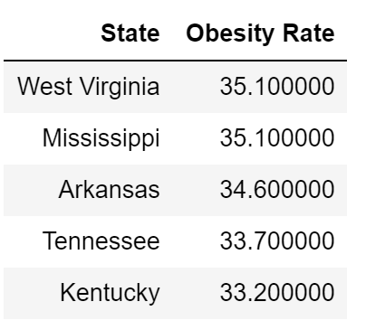
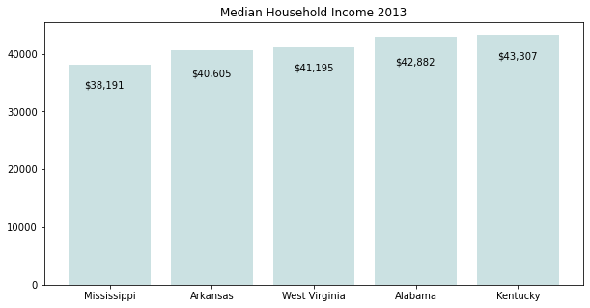
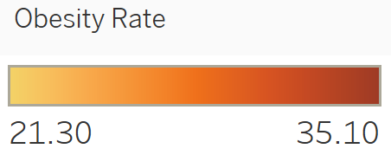
Obesity rates, Income, Poverty 2013..
Average Median Income
$52,250
National Poverty Rate
15.8%
Obesity Rate
29.4%

Slide 7
Summary 2013
In 2013..
Over 44 million people in the US were classified as impoverished
Over 92 million people we classified at obese
Of the five states with the highest rates of obesity four of them rank top five for lowest median income

Slide 8
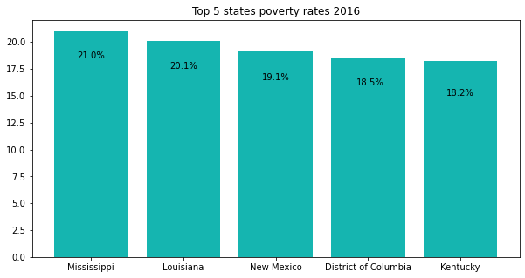
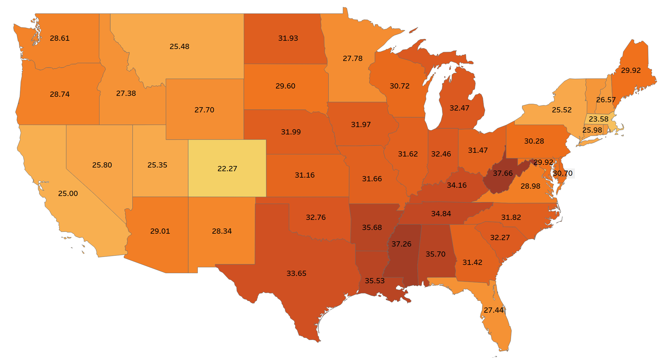
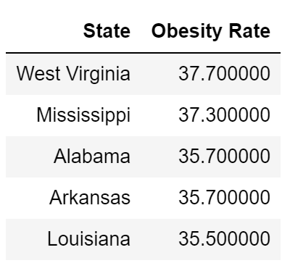
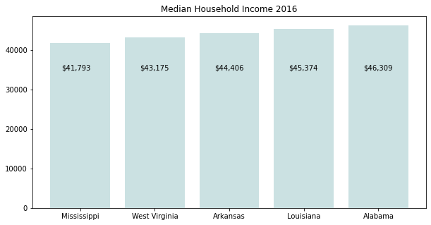

Obesity rates, Income, Poverty 2016..
Average Median Income
$57,617
National Poverty Rate
14.0%
Obesity Rate
29.9%

Slide 9
Summary 2016
Over 51 million people in the US were classified as impoverished
Over 96 million people we classified at obese
Of the five states with the highest rates of obesity all of them rank top five for lowest median income

Slide 10
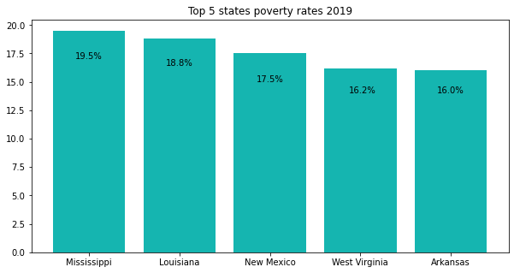
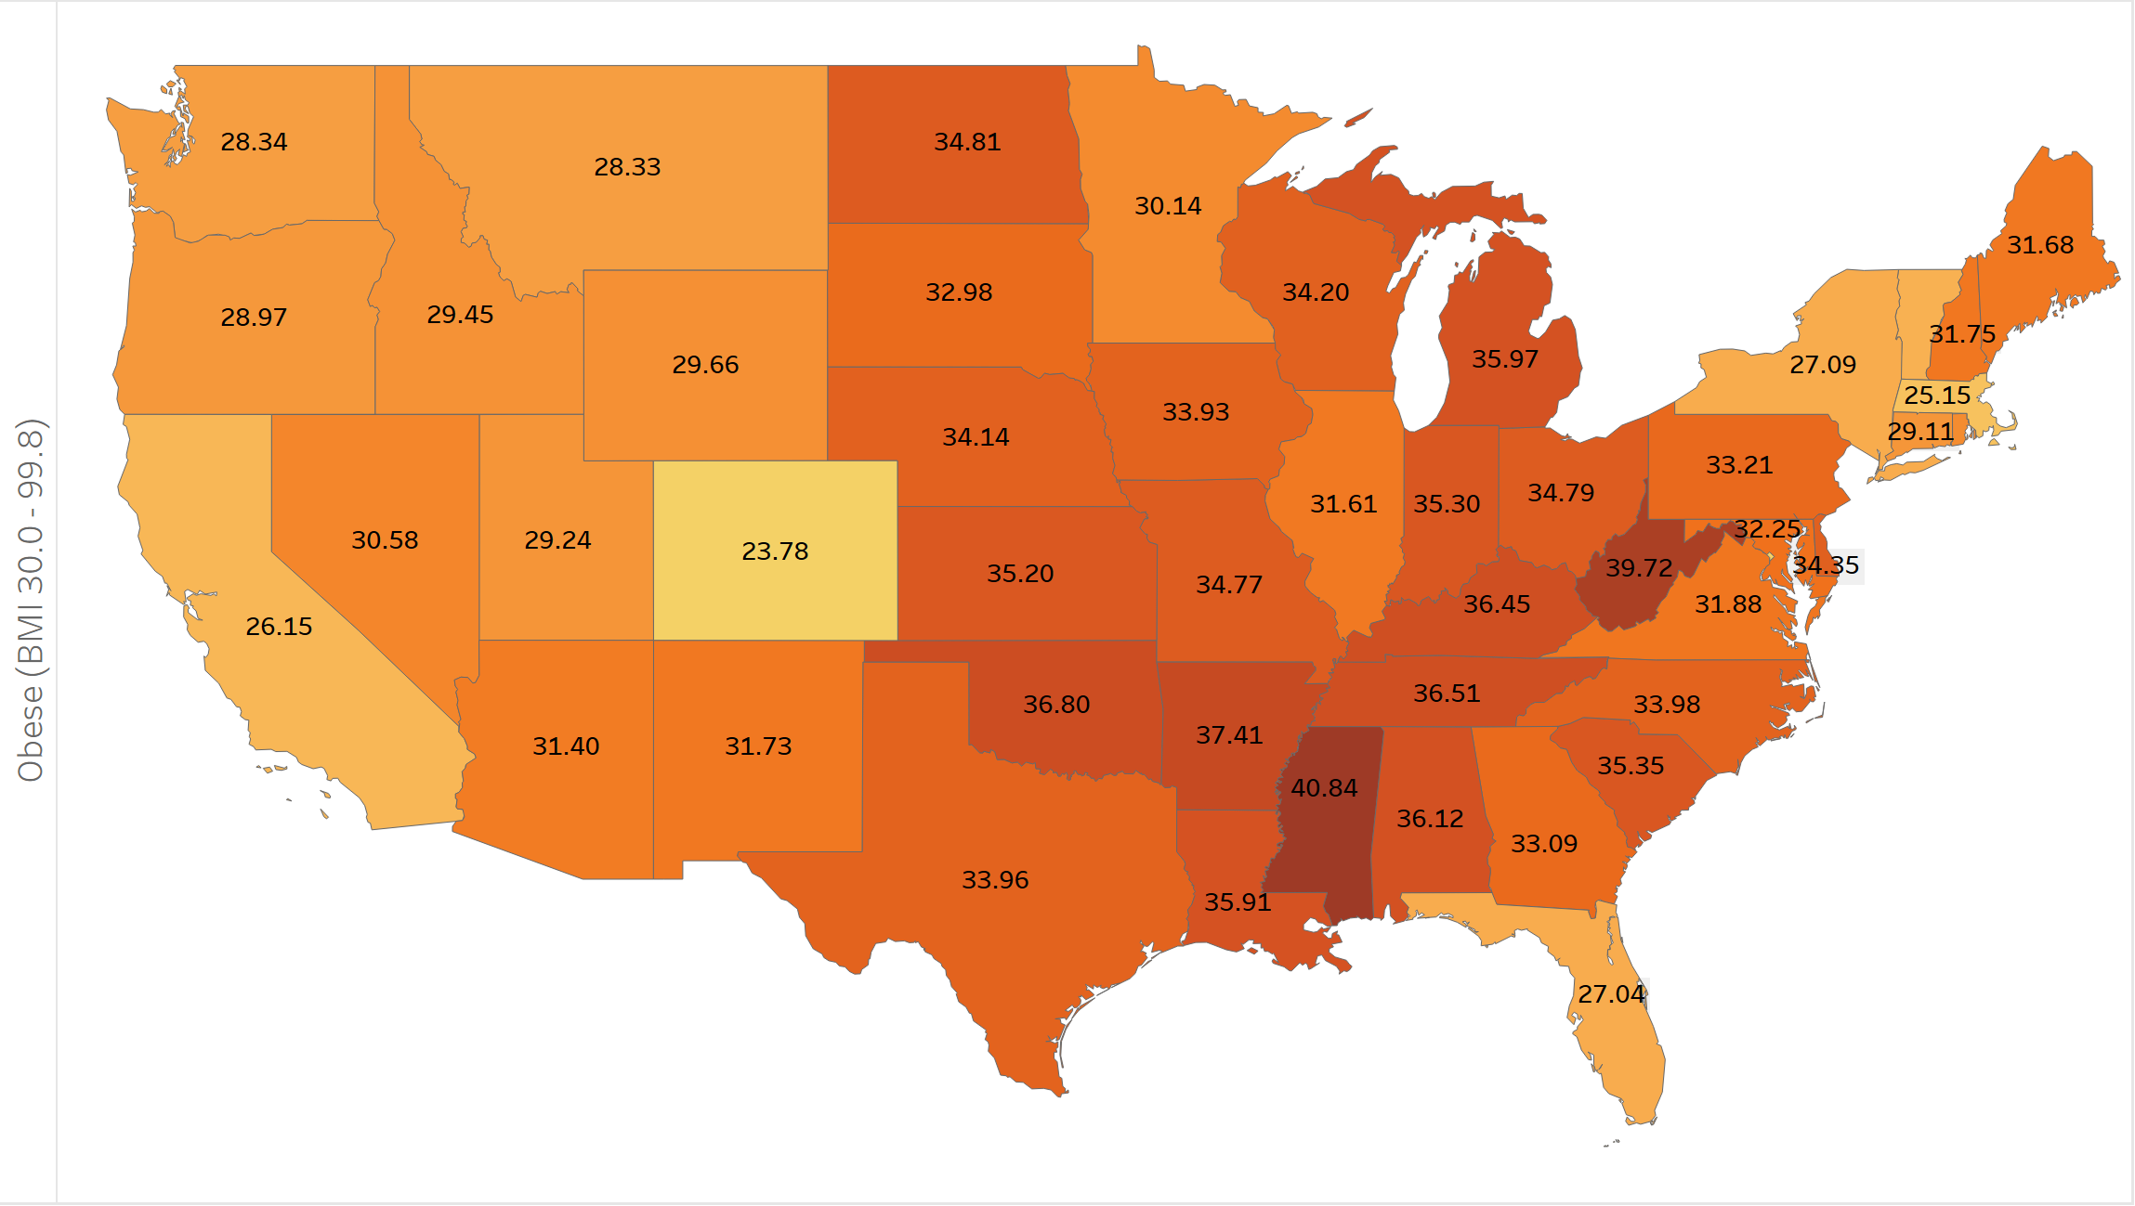
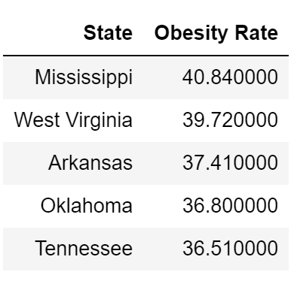
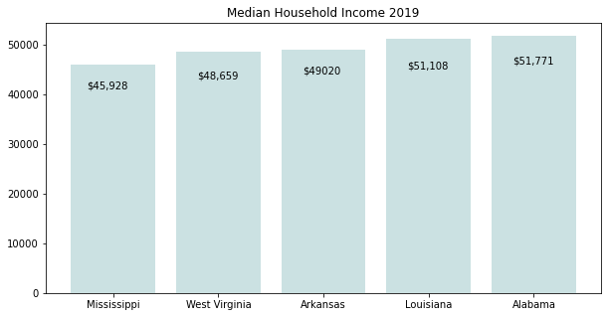

Obesity rates, Income, Poverty 2019..
Average Median Income
$65,712
National Poverty Rate
12.3%
Obesity Rate
32.1%

Slide 11
Summary 2019
Over 40 million people in the US were classified as impoverished
Over 105 million people we classified as obese
Of the five states with the highest rates of obesity three of them rank top five for lowest median income

Slide 12
Cost of Obesity
Personal Cost - Health insurance for obese people costs 25 to 50 percent more than coverage for people with a BMI below 30.
Zhou Yang, a professor at Emory University who studies the impact of obesity on the medical system, found that obese older males spent $190,657 more on lifetime health-care expenses than their normal-weight peers, while older obese women spent $223,629 more.
National cost of obesity - A 2016 meta-analysis by University of Washington researchers found that annual medical spending attributed to obesity nationally was nearly $150 billion

Slide 13
Increased Health Risks
High blood pressure (Hypertension)
Type 2 diabetes
Coronary heart disease
Stroke
Sleep apnea and breathing problems
Low quality of life
Mental illness such as clinical depression, anxiety, and other mental disorders
Body pain and difficulty with physical functioning

Slide 14
What does this all mean?
Over the course of this analysis Obesity rates in the U.S increased by 9%
Which evaluates to over 12 million more Americans that are classified as obese
State with higher rates of obesity are more likely to have lower median income and/or higher rates of poverty
Obesity Rates are at a constant rate of increase with no end in sight
The annual cost associated with Obesity will continue to rise at well
Why this data is so important, it creates a model to further analyze future data to and see the effects of major events such as the ongoing Coronavirus Pandemic

Slide 15

Any Questions?
Any Questions?

Slide 16
Data Sources
Census data from 2010- 2019 :
State Population Totals: 2010-2019 (census.gov)
Poverty rates, median income 2013-2019:
SAIPE State and County Estimates for 2019 (census.gov)
SAIPE State and County Estimates for 2016 (census.gov)
SAIPE State and County Estimates for 2013 (census.gov)
Obesity data by state :
BRFSS: Table of Overweight and Obesity (BMI) | Chronic Disease and Health Promotion Data & Indicators (cdc.gov)

Slide 17
Data Sources Continued…
The Health Effects of Overweight and Obesity | Healthy Weight, Nutrition, and Physical Activity | CDC
The enormous economic costs of America's obesity epidemic (theweek.com)
How Does Health Insurance for Obese People Work? | Freeway Insurance
The enormous economic costs of America's obesity epidemic (theweek.com)

